Slide 1
Data Analytics
Dr. Muhammad Abeer Irfan

Slide 2
Lecture Outline
T test
Examples
Types of T Test
One sample T test
Examples
Two sample T test
Examples
Welch's t-test
Examples
Student's t-test
Examples

Slide 3
Parametric tests are those that make assumptions about the parameters of the population distribution from which the sample is drawn.
This is often the assumption that the population data are
normally distributed.
Types of Parametric test
t-test.
z-test.
Analysis of variance (ANOVA)
Pearson coefficient of correlation.
Non-parametric tests are “distribution-free” and, as such, can be used for non-Normal variables.

Slide 4
T Test
A t test is a statistical test that is used to compare the means of two groups.
It is often used in hypothesis testing to determine whether a process or treatment actually has an effect on the population of interest, or whether two groups are different from one another.
Example
We want to know whether the mean petal length of iris flowers differs according to their species. You find two different species of irises growing in a garden and measure 25 petals of each species. You can test the difference between these two groups using a t test and null and alterative hypotheses.
The null hypothesis (H0) is that the true difference between these
group means is zero.
The alternate hypothesis (Ha) is that the true difference is different from zero.

Slide 5
T Test
Example
Business might use a t-test to determine if a new advertising campaign is more effective than the previous one.
In healthcare, t-tests can be used to compare the effectiveness of different treatments for a particular disease.
In education, t-tests can be used to determine if there is a significant difference in test scores between two groups of students who received different teaching methods.
Overall, the t-test is a powerful tool in statistics that helps us make decisions based on data and provides a way to measure the reliability of our conclusions.

Slide 6
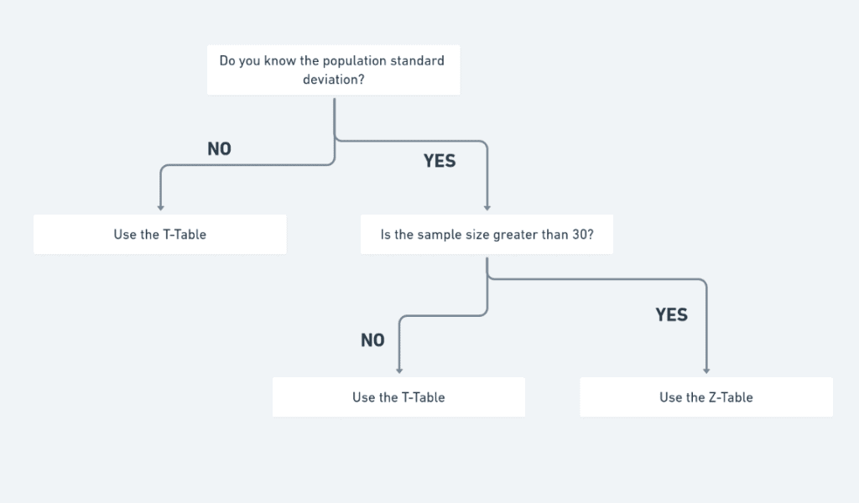
T Test

Slide 7
Types of t Test
Paired t Test: If the groups come from a single population (e.g., measuring before and after an experimental treatment), perform a paired t test. This is a within-subjects design.
One sample t Test: If there is one group being compared against a standard value (e.g., comparing the acidity of a liquid to a neutral pH of 7), perform a one-sample t test.
Independent sample t Test: The independent sample t-test compares the mean of one distinct group to the mean of another group. It is also called Two sample t Test
Two sample t Test: If the groups come from two different populations (e.g., two different species, or people from two separate cities), perform a two-sample t test (a.k.a. independent t test). This is a between-subjects design.

Slide 8
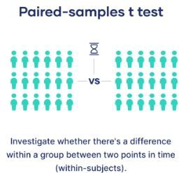
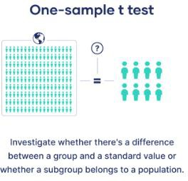
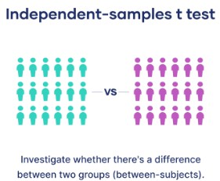
T Test

Slide 9
Paired Sample t Test
The mean of the same group or population is at separate times
or
A paired t-test is used to compare two population means where you have two samples in which observations in one sample can be paired with observations in the other sample.
Examples of where this might occur are:
Before-and-after observations on the same subjects
(e.g. students’ diagnostic test results before and after a particular module or course).
A comparison of two different methods of measurement or two different treatments where the measurements/treatments are applied to the same subjects
(e.g. blood pressure measurements using a stethoscope and a dynamap).

Slide 10
Paired Sample t Test
The Paired Samples t Test is commonly used to test the following:
Statistical difference between two time points
Statistical difference between two conditions
Statistical difference between two measurements
Statistical difference between a matched pair
Notes:
Statistical difference between two time points: This refers to testing whether there is a significant difference between measurements or observations taken at two different points in time. It's commonly used in longitudinal studies or before-and-after interventions.
Example: Testing whether there is a significant difference in blood pressure before and after a new medication is administered to patients.
Statistical difference between two conditions: This involves comparing data from two different experimental conditions or groups to see if there is a significant difference between them. It's often used in experimental studies with control and experimental groups.
Example: Comparing the average exam scores of students who studied with flashcards versus those who studied with textbooks to determine if one method is more effective.
Statistical difference between two measurements: This is used when comparing two different measurements or variables to assess if there is a significant difference between them. It's common in studies where multiple variables are measured.
Example: Investigating whether there is a significant difference in height between males and females in a population.
Statistical difference between a matched pair: This refers to testing whether there is a significant difference between two related measurements taken from the same individual or item. It's used when each data point in one group is paired or matched with a data point in the other group.
Example: Analyzing whether there is a significant difference in weight before and after a weight loss program for each participant in the program.

Slide 11
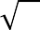
Procedure Paired Sample t Test
Example: Suppose a sample of n students were given a diagnostic test before studying a particular module and then again after completing the module. We want to find out if, in general, our teaching leads to improvements in students’ knowledge/skills (i.e. test scores). We can use the results from our sample of students to draw conclusions about the impact of this module in general.
Let x = test score before the module, y = test score after the module
Procedure:
Calculate the difference (𝑑_{𝑖} = 𝑦_{𝑖} - 𝑥_{𝑖}) between the two observations on each pair, making sure you distinguish between positive and negative differences.
Calculate the mean difference, 𝑑 .
Calculate the standard deviation of the differences, 𝑠_{𝑑}, and use this to calculate the
standard error of the mean difference, 𝑆𝐸(𝑑 ) = ^{𝑠𝑑}
𝑛
4. Calculate the t-statistic, which is given by T=
_{𝑑}
Under the null hypothesis, this
𝑆𝐸(𝑑 )
statistic follows a t-distribution with n − 1 degrees of freedom.
5. Use tables of the t-distribution to compare your value for T to the 𝑡_{𝑛−1} distribution.
This will give the p-value for the paired t-test.

Slide 12
Paired Sample t Test
Example: Suppose we conduct a two-sided hypothesis test at alpha level 0.05 to find out if mean weight loss differs between two diets. Suppose our test statistic t is 1.34 and our degrees of freedom is 22. We would like to know if these results are statistically significant.
Solution
Compare the test statistic t to a critical value
The first approach we can use to determine if our results are statistically significant is to compare the test statistic t of 1.34 to the critical value in the t distribution table. The critical value is the value in the table that aligns with a two-tailed value of 0.05 and a degrees of freedom of 22. This number turns out to
be 2.074:

Slide 13
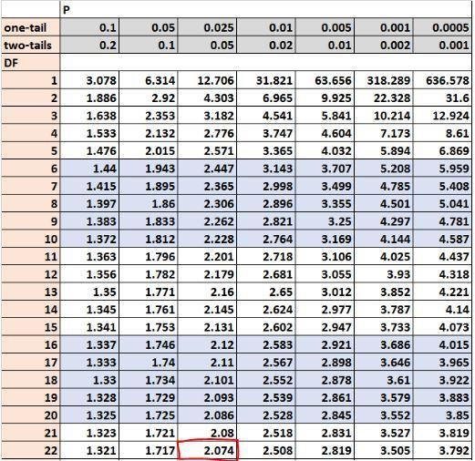
Paired Sample t Test
Since out test statistic t (1.34) is smaller than the critical value (2.074), we fail to reject the null
hypothesis of our test.

Slide 14
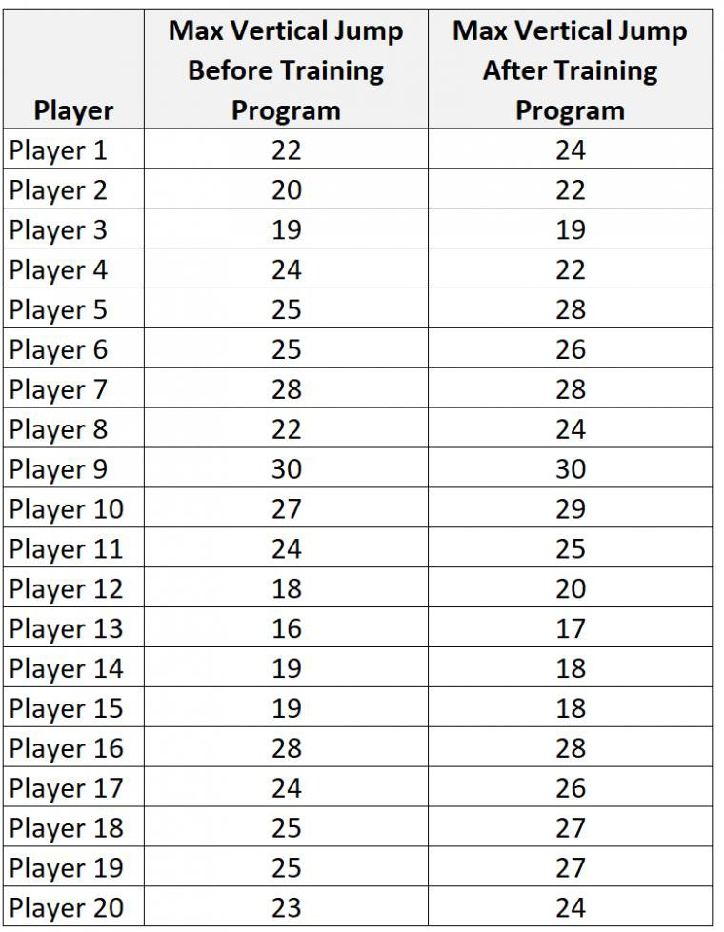
Paired Sample t Test using P value
Example: Suppose we want to know whether or not a certain training program is able to increase the max vertical jump (in inches) of college basketball players. To test this, we may recruit a simple random sample of 20 college basketball players and measure each of their max vertical jumps. Then, we may have each player use the training program for one month and then measure their max vertical jump again at the end of the month.

Slide 15
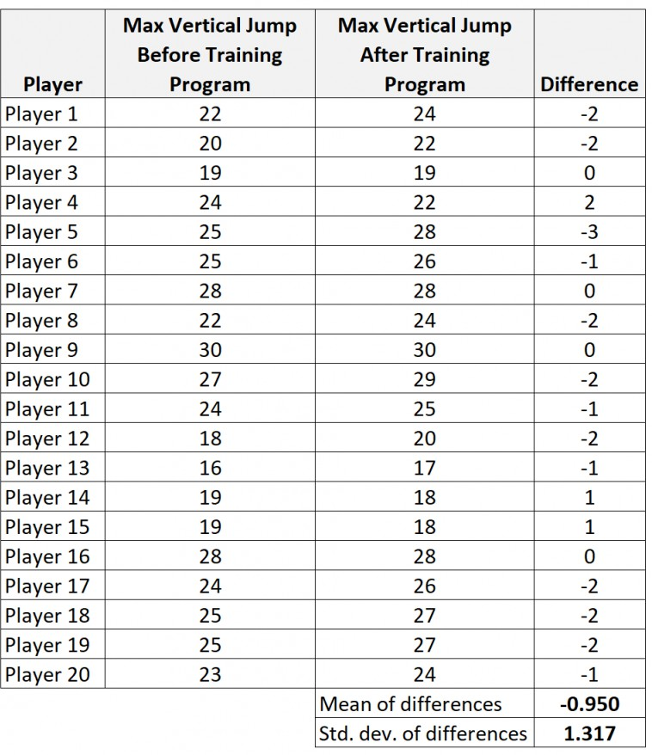
Paired Sample t Test using P value
Calculate the summary data for the differences.
x_{diff}: sample mean of the differences = -0.95 s: sample standard deviation of the differences = 1.317
n: sample size (i.e. number of pairs) = 20
Define the hypotheses.
We will perform the paired samples t-test with the following hypotheses:
H₀: μ₁ = μ₂ (the two population means are equal)
H₁: μ₁ ≠ μ₂ (the two population means are not equal)

Slide 16
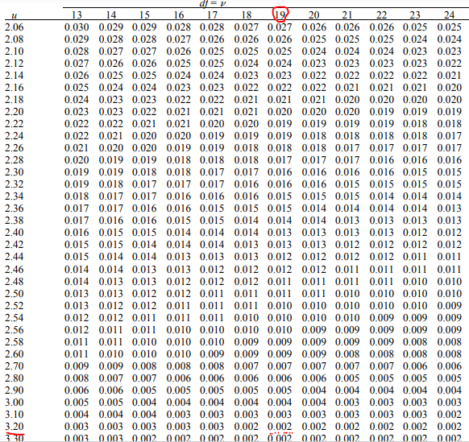
Paired Sample t Test using P value
Calculate the test statistic t. t = xdiff / (sdiff/√n) = -0.95 / (1.317/√20) = -3.226
Calculate the p-value of the test
statistic t.
According to the T Score to P Value Calculator,
the p-value associated with t = -3.226 and degrees of freedom = n-1 = 20-1 = 19 is 0.00445.
Draw a conclusion.
Since this p-value is less than
our significance level α = 0.05, we reject
the null hypothesis.

Slide 17
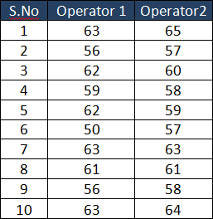
Example of Two-tailed Paired T-test
Example: Two operators are checking the same dimension on the same sample of 10 parts. Below are the results. Is there a significant operator measurement error? Test at the 5% significance level.

Slide 18
Example of Two-tailed Paired T-test
Solution
We need to calculate the T-Statistic value using, t= (x̅ – µ)/ s/√n
and then compare it to a table value t _{critical}.
H₀ =There is no significant measurement error between the two operators.
H₁ =There is a significant measurement error between the two
operators.
n=10
DF (degrees of freedom) = n-1 ; 10-1 =9
Significance level =5%

Slide 19
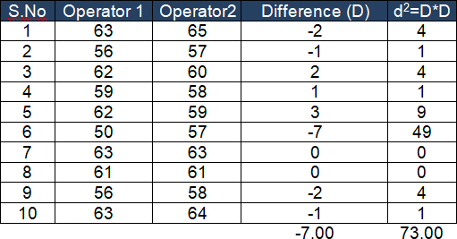
Example of Two-tailed Paired T-test
Compute the mean difference (x̅ – µ)
µ (mean of first test) = 59.5 ; take the average of the 10 data points in Op1
x̅ (mean of new test) = 60.2 ; take the average of the 10 data points in Op2
x̅-µ = 60.2 – 59.5 =0.7
Calculate the Standard Deviation of differences (s)
D= -7 ; d²=73
Use s_{d} = sqrt [ (Σ(d_{i} – d)² / (n – 1) ] where d_{i} is
the difference for pair i, d is the sample mean
of the differences, or s=( √ ((n*d²)-D²)/df) /
√(n)
s = (√ ((10*73) -(-7*-7)/9) / √(10) = 2.7508
Calculate the standard error
Standard error = s/√n = 2.7508 / √10 = 0.869
Compute the T-Statistic
t= (x̅ – µ)/ s/√n = (0.7) / 0.869 = 0.805
Determine t critical value with n-1 degrees of freedom
Since this is a Two-tailed test at an alpha of 5% t _{critical} = 2.262

Slide 20
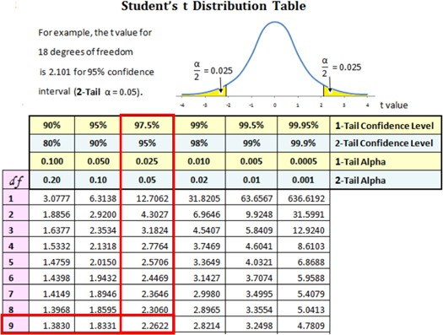
Example of Two-tailed Paired T-test
Interpret the results
Compare t
statistic
to In a
t _{critical} 0.805 < 2.262. Hypothesis Testing,
critical value is a point on the test distribution that is compared to the test statistic to determine whether to reject the Null Hypothesis.
The t calculated is not in the rejection region. Hence, we fail to reject the Null Hypothesis and say that there is no difference between the two mean values.

Slide 21
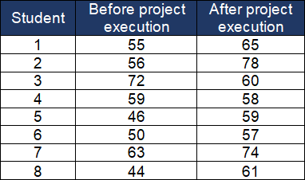
Example of One-tailed (Right) Paired t-test
Example: Artificial Intelligence (AI) training institute evaluating the effectiveness of training by comparing AI knowledge of the students before and after the execution of live projects. At a 95% confidence level, does this information provide sufficient evidence to indicate that the live projects will improve the students’ AI knowledge?

Slide 22
Example of One-tailed (Right) Paired t-test
Solution Details:
We need to calculate the T-Statistic value using, t = (x̅ – µ)/ s/√n and then compare it to a table value t _{critical}.
H₀ = There is no significant change in AI knowledge before and after the execution of live projects.
H1 = There is a significant improvement in AI knowledge before and after the execution of live projects.
n=8
DF (degrees of freedom) = n-1 ; 8-1 =7 Significance level =5%

Slide 23
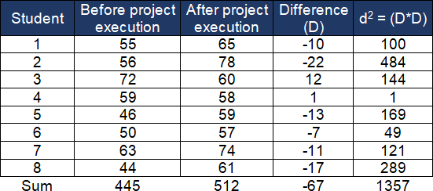
Example of One-tailed (Right) Paired t-test
Compute the mean difference (x̅ – µ)
µ (mean of the first test) = 55.625; take the average of the 8 data points before the project execution
x̅ (mean of the new test) = 64; take the average of the 8 data points after the project execution
x̅-µ = 64 – 55.625 =8.375
Calculate the standard
deviation of differences (s)
D= -67 ; d² = 1357
Use s_{d} = sqrt [ (Σ(d_{i} – d)² / (n – 1) ] where d_{i} is the difference for pair i, d is the sample mean of the differences, or s=( √ ((n*d²)-D²)/df) / √(n)
s=(√ ((8 * 1357) -(-67 * -67) /
7) / √(8) = 10.66
Calculate the standard error
Standard error = s/√n =10.66 / √8 = 3.769
Compute the T-Statistic
t = (x̅ – µ)/ s/√n = (8.375) / 3.769 = 2.221 Determine t critical value with n-1 degrees of freedom
Since this is a One-tailed (right-tailed) test at an alpha of 5% t _{critical} = 1.8946
24

Slide 24
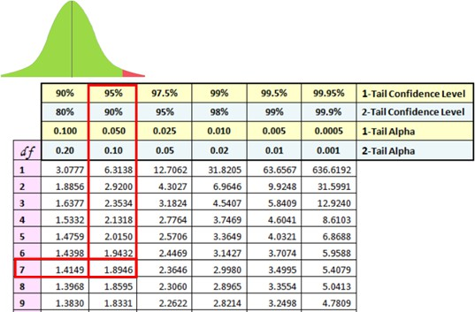
Example of One-tailed (Right) Paired t-test
Interpret the results
Compare t
statistic
to In
t 2.221 > 1.8946.
critical
Hypothesis Testing, a critical value is a point on the test distribution that is compared to the test statistic to determine whether to reject the null hypothesis.
The t calculated is greater than the critical value and it is in the rejection region. Hence, we can reject the Null Hypothesis and say that there is a significant improvement in AI knowledge before and after the execution of live projects.

Slide 25
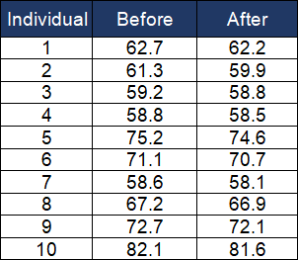
Example of One-tailed (Left) Paired t- test
Example: A dietician is evaluating the individual weights before and after following the diet plan. At a 95% confidence level, is there any significant evidence of the reduction of weight of the individuals?

Slide 26
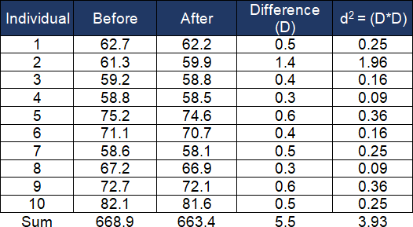
Example of One-tailed (Left) Paired t- test

Slide 27
Example of One-tailed (Left) Paired t-
test
Compute the mean difference (x̅ – µ)
µ (mean of the first test) = 66.89; take the average of the 10 data points before the diet plan
x̅ (mean of the new test) = 66.34; take the average of the 10 data points after
the diet plan
x̅-µ = 66.34 – 66.89= -0.55
Calculate the standard deviation of differences (s)
D= 5.5 ; d²= 3.93
Use s_{d} = sqrt [ (Σ(d_{i} – d)² / (n – 1) ] where d_{i} is the difference for pair i, d is the
sample mean of the differences, or s=( √ ((n*d²)-D²)/df) / √(n)
s=(√ ((10*3.93) -(5.5 * 5.5) / 9) / √(10) = 0.3171
Calculate the standard error
Standard error = s/√n =0.3171 / √10 =0.1002
Compute the T-Statistic
t= (x̅ – µ)/ s/√n = (0.55) / 0.1002 = -5.484
Determine t critical value with n-1 degrees of freedom
Since this is a One-tailed (left-tailed) test at an alpha of 5% t _{critical} = -1.833

Slide 28
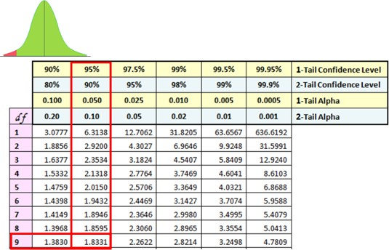
Example of One-tailed (Left) Paired t- test
Interpret the results
^{Compare t} statistic ^{to t} critical ⁻ 5.484<-1.833. In Hypothesis
Testing, a critical value is a point on the test distribution that is compared to the test statistic to determine whether to reject the Null Hypothesis.
The t calculated is less than the critical value and it is in the rejection region.
Hence, we can reject the Null Hypothesis and say that there is a significant reduction in individual weights before and after the diet plan.

Slide 29


T Test
Example: An instructor wants to use two exams in her classes next year. This year, she gives both exams to the students. She wants to know if the exams are equally difficult and wants to check this by looking at the differences between scores. The test is two-sided and set α = 0.05. If the mean difference between scores for students is “close enough” to zero, she will make a practical conclusion that the exams are equally difficult. Here is the data:
Student | Exam 1 Score | Exam 2 Score | Differenc e
Bob | 63 | 69 | 6
Nina | 65 | 65 | 0
Tim | 56 | 62 | 6
Kate | 100 | 91 | -9
Alonzo | 88 | 78 | -10
Jose | 83 | 87 | 4
Nikhil | 77 | 79 | 2
Julia | 92 | 88 | -4
Tohru | 90 | 85 | -5
Michael | 84 | 92 | 8
Jean | 68 | 69 | 1
Indra | 74 | 81 | 7
Susan | 87 | 84 | -3
Allen | 64 | 75 | 11
Paul | 71 | 84 | 13
Edwina | 88 | 82 | -6

Slide 30
T Test
The average score difference is:
𝑥_{𝑑} =1.31
𝑆𝑡𝑎𝑛𝑑𝑎𝑟𝑑 𝐸𝑟𝑟𝑜𝑟 𝑆𝐸(𝑑 ) = ^{𝑠𝑑} =
7
= 1.75
𝑛
16
t=Average difference/ Standard Error t=1.31 / 1.75 = 0.750
The software shows a p-value of 0.4650 for the two-sided test.

Slide 31
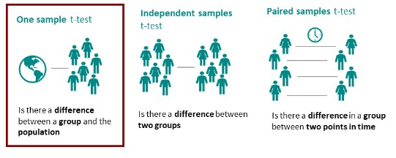
T Test
The t-test is one of the most common hypothesis tests in statistics. The t-test determines either whether the sample mean and the mean of the population differ or if two sample means differ statistically. The t-test distinguishes between
one sample t-test
independent sample t-test
paired samples t test

Slide 32
One Sample T Test
What is the one-sample t-test?
The one-sample t-test is a statistical hypothesis test used to determine whether an unknown population mean is different from a specific value.
Examples
The average birth weight for white babies in the US is 3,410 grams and wish to compare the average birth weight of a sample of black babies to this value.
Find out whether the health perception of managers in Canada differs from that of the population as a whole. For this purpose we ask 50 managers about their perception of health.
Find out if the screws a company produces really weigh 10 grams on average. To test this, weigh 50 screws and compare the actual weight with the weight they should have (10 grams).
A pharmaceutical company promises that its new drug lowers blood pressure by 10 mmHg in a week. To find out if this is correct. Compare the observed reduction in blood pressure of 75 test subjects with the expected reduction of 10 mmHg.

Slide 33
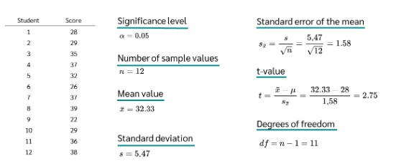
One Sample T Test
The one sample t test, also referred to as a single sample t test, is a statistical hypothesis test used to determine whether the mean calculated from sample data collected from a single group is different from a designated value specified by the researcher.

Slide 34
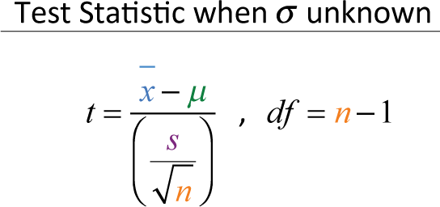
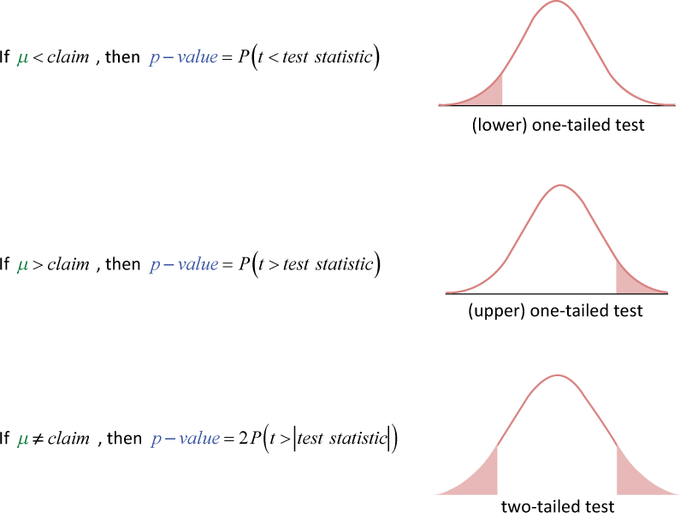
One Sample T Test
If the population standard deviation is unknown, Then use a sample standard deviation that will be close enough to the unknown population standard deviation. But this will also cause us to have to use a t-distribution instead of a normal distribution
Our test statistic will be a t-value rather than a z-value. But thankfully, how we find our p-value and draw our final inference is the same as for hypothesis testing for proportions

Slide 35
One Sample T Test using P Value
Example: A small company wants to test the claim that their manufactured bulbs last more than 40 hours. Using a simple random sample of 15 bulbs yielded a mean of 44.9 hours, with a standard deviation of 8.9 hours. Test this claim using a significance level of 0.05.

Slide 36
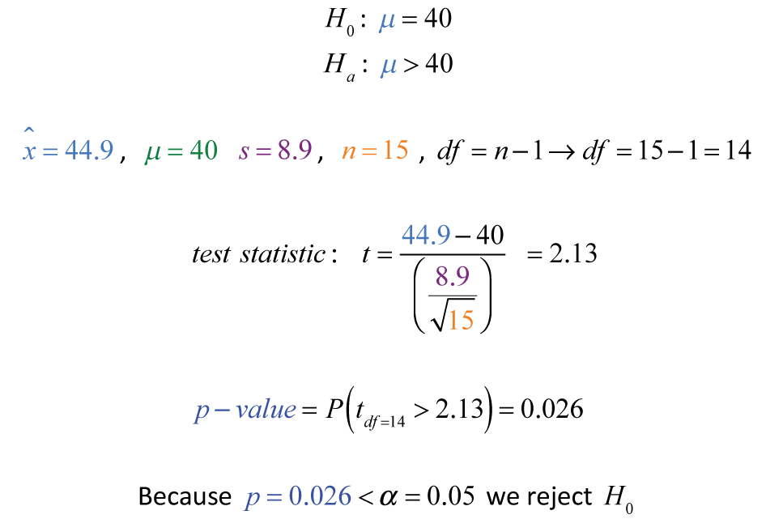
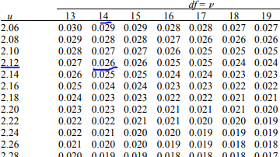
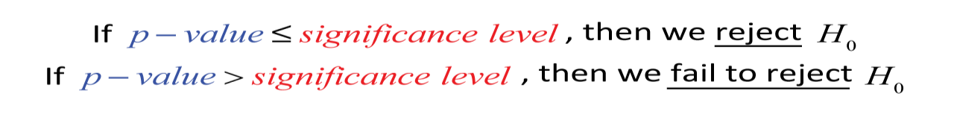
One Sample T Test using P Value
Example: A small company wants to test the claim that their manufactured bulbs last more than 40 hours. Using a simple random sample of 15 bulbs yielded a mean of 44.9 hours, with a standard deviation of 8.9 hours. Test this claim using a significance level of 0.05.

Slide 37
One Sample T Test
Example: Ali collect tomato's that is produced from 12 different farmhouses. Ali know that the standard tomato yield for the given variety is µ=20. x = [21.5, 24.5, 18.5, 17.2,
14.5, 23.2, 22.1, 20.5, 19.4, 18.1, 24.1, 18.5] Test if the
tomato produced from these farmhouses is significantly
better than the standard yield for 0.05 significance level.

Slide 38
One Sample T Test
Solution:
Step 1: Define the Null and Alternate Hypothesis
H0: x̅ = 20 H1: x̅ > 20
n = 12. Since this is one sample T test,
the degree of freedom = n-1 = 12-1 = 11.
Let’s set alpha = 0.05, to meet 95% confidence level.
Step 2: Calculate the Test Statistic (T)
Sample mean 𝑥 = 20.175
Sample standard deviation σ = 3.0211
T Statistic formula = T=(20.175–20)/(3.0211/√12)=0.2006 Step 3: Find the T-Critical
Confidence level = 0.95, alpha=0.05. For one tailed test, look under 0.05 column. For df = 12 – 1 = 11,
T-Critical = 1.796.

Slide 39
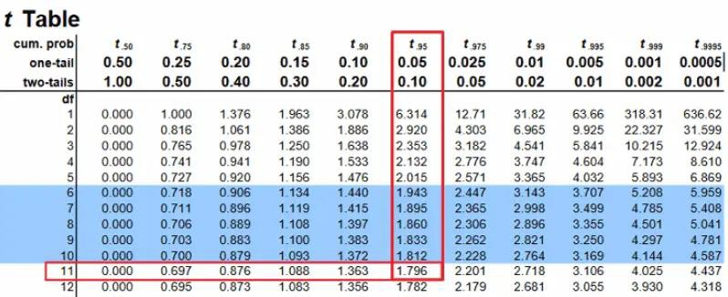
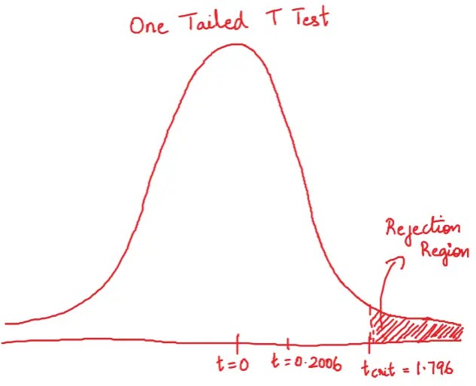
One Sample T Test
Step 4: Does it fall in
rejection region?
Since the computed T Statistic is less than the T- critical, it does not fall in the rejection region.
Clearly, the calculated T statistic does not fall in the rejection region. So, we do not reject the null hypothesis.

Slide 40
One Sample T Test
Example: In IMSciences, A Lecturer wants to know if is introductory statistics class has a good grasp of basic math. Six students are chosen at random from the class and given a math proficiency test. The teacher wants the class to be able to score above 70 on the test. The six students get scores of 62, 92, 75, 68, 83, and 95. Can the teacher have 90 percent confidence that the mean score for the class on the test would be above 70?

Slide 41
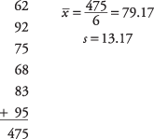
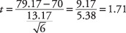
One Sample T Test
Step 1: Define the Null and Alternate Hypothesis
null hypothesis: H ₀: μ = 70
alternative hypothesis: H _{a} : μ > 70
First, compute the sample mean and standard deviation:
Step 2: Calculate the Test Statistic (T)

Slide 42
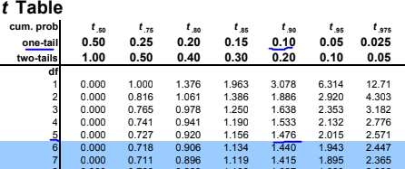
One Sample T Test
Step 3: Find the T-Critical
A 90 percent confidence level is equivalent to an alpha level of 0.10.
The number of degrees of freedom for the problem is 6 – 1 = 5.
The value in the t‐table for t _{.10,5} is
1.476.
Step 4: Decision
The computed t‐value of 1.71 is larger than the critical value in the table, the null hypothesis can be rejected, and the lecturer has evidence that the class mean on the math test would be at least 70.

Slide 43
One Sample T Test
Example: Pakistan A hockey team coach wants to know if his team is representative of other teams in scoring goals. Nationally, the average number of goal scored by a Pakistan A team in a game is 5.7. He chooses five games at random in which his team scored 5 , 9, 4, 11, and 8 goals. Is it likely that his team's goal could have come from the national distribution? Assume an alpha level of 0.05.

Slide 44
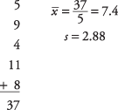
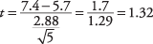
One Sample T Test
Solution:
Step 1: Define the Null and Alternate Hypothesis null hypothesis: H ₀: μ = 5.7
alternative hypothesis: H _{a} : μ ≠ 5.7
Step 2: Calculate the Test Statistic (T)
Step 3: Find the T-Critical
The degrees of freedom is 5 – 1 = 4.
The overall alpha level is 0.05, but because this is a two‐tailed test, the alpha level must be divided by two, which yields 0.025.
The tabled value for t _{.025,4}is 2.776.

Slide 45
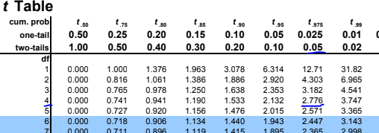
One Sample T Test
Step 4: Decision
The computed t of 1.32 is smaller, so you cannot reject the null hypothesis that the mean of this team is equal to the population mean. The coach cannot conclude that his team is different from the national distribution on goal scored.

Slide 46
Two sample T test
The two-sample t-test (Snedecor and Cochran, 1989) is used to determine if two population means are equal. A common application is to test if a new process or treatment is superior to a current process or treatment.
The two-sample t-test (also known as the independent samples t-test) is a method used to test whether the unknown population means of two groups are equal or not.
Independent samples t-test is also called unpaired two-samples t-test because the test is performed with only two groups that are independent or unpaired or unrelated.

Slide 47
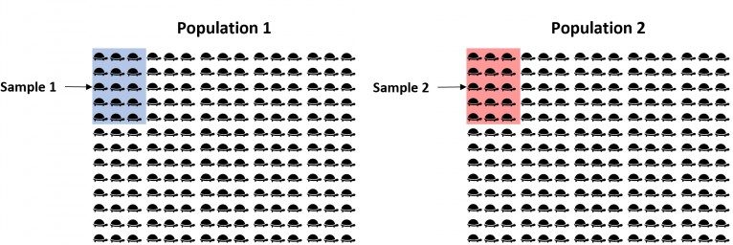
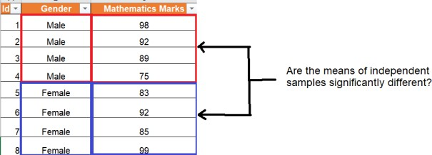
Two sample T test
Example: To check mean weight between two different species of turtles is equal or not. Since there are thousands of turtles in each population, it would be too time-consuming and costly to go around and weigh each individual turtle.
Example: Two independent groups of marketing professionals having similar qualification and we want to compare their income to
determine income different.
whether their
is significantly

Slide 48
Two sample T test
Real-life examples where two-sample T-test for independent samples
Business and finance
Comparing the sales performance of two products
Analyzing the effectiveness of two marketing strategies
Healthcare and medicine
Examining the effects of two treatments on patient outcomes
Comparing the mean blood pressure levels of two patient groups
Social sciences
Analyzing the differences in academic performance between two schools
Comparing the mean levels of happiness among two age groups

Slide 49
Independent Samples with Unknown Standard Deviation (Two-Sample t- test): This type of t-test is used when comparing the means of two independent groups or populations, and the standard deviation for each group is unknown. The test can be performed assuming equal variances (pooled variances) or unequal variances (unpooled variances).
Pooled Variances: The pooled variances t-test assumes that the variances of the two groups being compared are equal also called Student t test. This is often used when there is no prior knowledge or reason to suspect that the population variances differ. The pooled variances t-test calculates a common variance estimate by pooling the sample variances from both groups.
Unpooled Variances: The unpooled variances t-test, also known as Welch's t-test, does not assume equal variances between the two groups. It is used when there is a reason to believe or evidence suggesting that the population variances differ. This test adjusts for unequal variances by using separate variance estimates for each group.

Slide 50
Two sample T test
Assumptions related to Independent Samples T-test
Assumes that the two samples are independent from each
other.
Assumes that the two populations have normal distributions.
Assumes the homogeneity of variance between the two groups.
Assumes that measurements made on the same group of objects are statistically independent of each other.
Assumes that all observations within each sample are randomly
selected and independently distributed.
Assumes that there is an equal or nearly equal sample size between the two groups being tested.

Slide 51
Two sample T test
Welch's t-test
Welch's t-test does not assume equal variances.
It is also known as the "unpaired t-test with unequal variances" or the "unequal variances t-test" .
Welch's t-test adjusts for unequal variances by modifying the degrees of freedom and the calculation of the t-statistic
Student t test
The Student's t-test assumes equal variances between the two groups being compared.
This assumption is known as the "homogeneity of variances" assumption.
If this assumption is violated, meaning the variances between the groups are significantly different, using the Student's t-test can lead to inaccurate results.

Slide 52
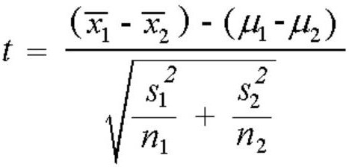
Welch's t-test
Welch's t-test statistics when homogeneity of variances does not hold good (variances not equal)
When the variances of populations are not equal,
𝑥₁ is mean of first sample
𝑥₂ is mean of second sample
𝜇₁ is the mean of first population
𝜇₂ is the mean of second population
𝑠₁
𝑠₂
𝑛₁
𝑛₂
is the standard deviation of first sample is the standard deviation of second sample is the size of the first sample
is the size of the second sample
Degrees of freedom, df =(s ²/n + s ²/n )² / { [ (s ² / n )² / (n – 1) ] + [
1 1 2 2 1 1
1
(s ² / n )² / (n – 1) ] }
2 2 2

Slide 53
Welch's t-test
Example: Perform Welch’s t-test on the following two samples to determine if their populations means differ significantly at a significance level of 0.05:
Sample 1: 14, 15, 15, 15, 16, 18, 22, 23, 24, 25, 25
Sample 2: 10, 12, 14, 15, 18, 22, 24, 27, 31, 33, 34, 34, 34
Solution
Mean of first sample x₁ – 19.27
Mean of second sample x₂ – 23.69
s₁² – 20.42
s₂² – 83.23
n₁ – 11
n₂ – 13

Slide 54
Welch's t-test
Test statistic: (x₁ – x₂) / (√s₁²/n₁ + s ²/n₂)
2
Test statistic: (19.27 – 23.69) / (√20.42/11 + 83.23/13)
= -4.42 / 2.873 = -1.538
Degrees of freedom: (s₁²/n₁ + s ²/n₂)² / { [ (s₁² / n₁)² / (n₁ –
2
1) ] + [ (s ² / n )² / (n – 1) ] }
2 2 2
Degrees of freedom: (20.42/11 + 83.23/13)² / { [ (20.42/11)² / (11 – 1) ] + [ (83.23/13)² / (13 – 1) ] } =
18.137. We round this down to the next nearest integer
of 18.

Slide 55
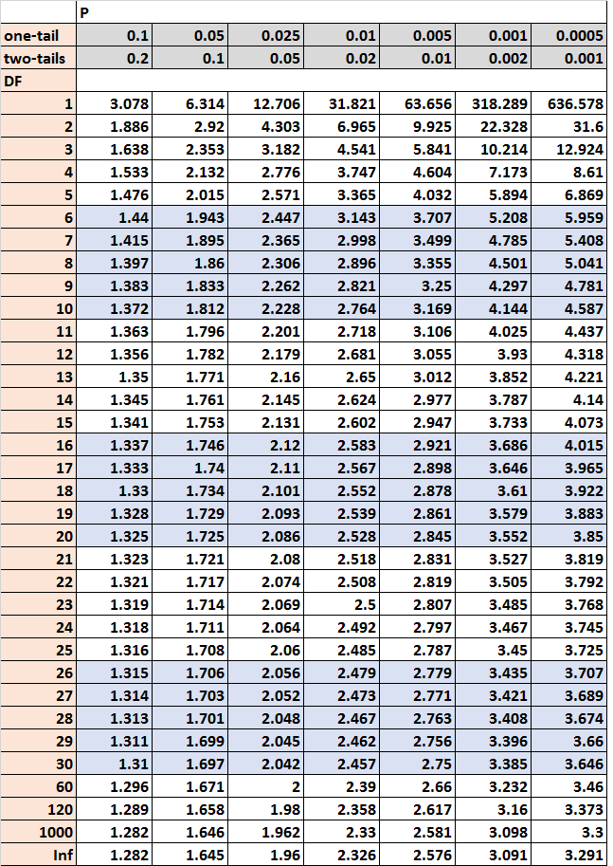
Welch's t-test
Lastly, we will find the t critical value in the t-distribution table that corresponds to a two-tailed test with alpha = .05 for 18 degrees of freedom:
Decision:
The t critical value is 2.101. Since the absolute value of our test statistic (1.538) is not larger than the t critical value, we fail to reject the null hypothesis of the test. There is not sufficient evidence to say that the means of the two populations are significantly different.

Slide 56
Welch's t-test
Example: A researcher wants to compare the effectiveness of two different teaching methods, Method A and Method B, in improving students' test scores. They collect test scores from two independent groups of students. The sample statistics are as follows:
Method A group:
Sample size (n1) = 25 Mean (x̄1) = 78
Standard deviation (s1) = 6.5
Method B group:
Sample size (n2) = 30 Mean (x̄2) = 82
Standard deviation (s2) = 7.2
The researcher wants to determine if there is a significant difference in the mean test scores between the two teaching methods. Assume that the population variances are not equal. Conduct a Welch T Test

Slide 57

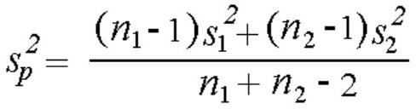
Student t-test
Students t-test statistics when homogeneity of variances hold good (variances equal)
When the variances of populations are equal, the following formula is used to calculate the T-statistics.
𝑥 ₁ is mean of first sample
𝑥 ₂ is mean of second sample
𝜇₁ is the mean of first population
𝜇₂ is the mean of second population
𝑠_{𝑝} termed as pooled standard deviation.
𝑛₁ is the size of the first sample
𝑛₂ is the size of the second sample
Degrees of freedom, df = n1 + n2 – 2

Slide 58
Student t-test
Example: The following two-sample t-test was generated. The data set contains miles per gallon for U.S. cars (sample 1) and for Japanese cars (sample 2); the summary statistics for each sample are shown below.
SAMPLE 1:
NUMBER OF OBSERVATIONS = 249 MEAN = 20.14458
STANDARD DEVIATION = 6.41470 STANDARD ERROR OF THE MEAN = 0.40652
SAMPLE 2:
NUMBER OF OBSERVATIONS = 79 MEAN = 30.48101
STANDARD DEVIATION = 6.10771 STANDARD ERROR OF THE MEAN = 0.68717
We are testing the hypothesis that the population means are equal for the two samples. We assume that the variances for the two samples are equal.
H0: μ1 = μ2
Ha: μ1 ≠ μ2

Slide 59
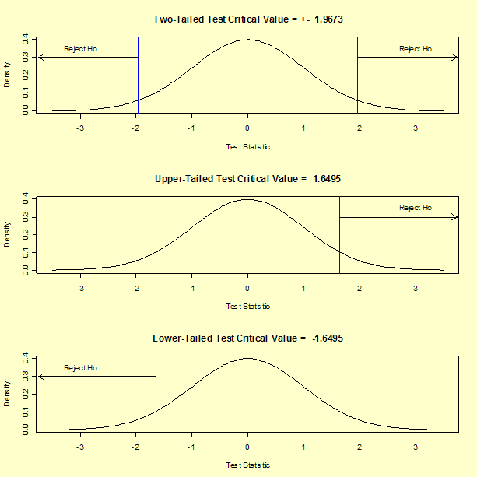
Student t-test
Test statistic: T = -12.62059 Pooled standard deviation: 𝑠_{𝑝} = 6.34260
Degrees of freedom: ν = 326 Significance level: α = 0.05 Critical value (upper tail): t1- α/2,ν = 1.9673
Critical region: Reject H0 if
|T| > 1.9673
The absolute value of the test statistic for our example, 12.62059, is greater than the critical value of 1.9673, so we reject the null hypothesis and conclude that the two population means are different at the 0.05 significance level.

Slide 60
Student t-test
Example
Suppose we want to know whether or not the mean weight between two different species of turtles is equal. To test this, will perform a two sample t-test at significance level α = 0.05 using the following steps:
Step 1: Gather the sample data.
Suppose we collect a random sample of turtles from each population with the following information:
Sample 1:
Sample size n₁ = 40
Sample mean weight x₁ = 300
Sample standard deviation s₁ = 18.5
Sample 2:
Sample size n₂ = 38
Sample mean weight x₂ = 305
Sample standard deviation s₂ = 16.7

Slide 61
Student t-test
Step 2: Define the hypotheses.
We will perform the two sample t-test with the following
hypotheses:
H₀: μ₁ = μ₂ (the two population means are equal)
H₁: μ₁ ≠ μ₂ (the two population means are not equal)
Step 3: Calculate the test statistic t.
First, we will calculate the pooled standard deviation s_{p}:
s_{p} = √ (n₁-1)s ² + (n₂-1)s₂² / (n₁+n₂-2) = √ (40-1)18.5² + (38-1) 16.7²
1
/ (40+38-2) = 17.647
Next, we will calculate the test statistic t:
t = (x₁ – x₂) / s_{p}(√1/n₁ + 1/n₂) = (300-305) /
17.647(√1/40 + 1/38) = -1.2508

Slide 62
Student t-test
Step 4: Calculate the p-value of the test statistic t.
According to the T Score to P Value Calculator, the p- value associated with t = -1.2508 and degrees of freedom = n1+n2-2 = 40+38-2 = 76 is 0.21484.
Step 5: Draw a conclusion.
Since this p-value is not less than our significance level α
= 0.05, we fail to reject the null hypothesis. We do not have sufficient evidence to say that the mean weight of turtles between these two populations is different.

Slide 63
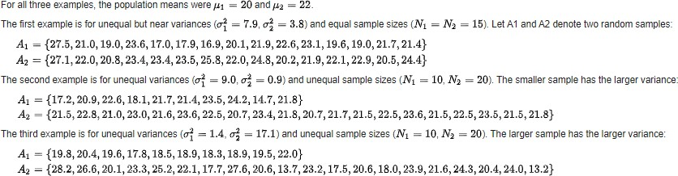
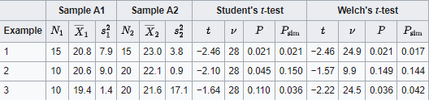
Student t-test

Slide 64
Student t-test
Welch's t-test and Student's t-test gave identical results when the two samples have similar variances and sample sizes (Example 1).
Note: even if you sample data from populations with identical variances, the sample variances will differ, as will the results of the two t-tests. So with actual data, the two tests will almost always give somewhat different results.
For unequal variances, Student's t-test gave a low p-value when the smaller sample had a larger variance (Example 2) and a high p-value when the larger sample had a larger variance (Example 3). For unequal variances, Welch's t-test gave p-values close to simulated p-values.

Slide 65
What is F-test?
An F-test is any statistical test in which the test statistic has an F-distribution under the null hypothesis. It is most often used when comparing statistical models that have been fit to a data set, in order to identify the model that best fits the population from which the data were sampled.
The name was coined by George W. Snedecor, in honour of Sir Ronald A. Fisher. Fisher initially developed the statistic as the variance ratio in the 1920s.
The F-test is designed to test if two population variances are equal. It does this by comparing the ratio of two variances. So, if the variances are equal, the ratio of the variances will be 1.

Slide 66
There are several different F-tables. Each one has a different level of significance.So, find the correct level of significance first, and then look up the numerator degrees of freedom and the denominator degrees of freedom to find the critical value.
The numerator degrees of freedom will be the degrees of freedom for whichever sample has the larger variance (since it is in the numerator) and the denominator degrees of freedom will be the degrees of freedom for whichever sample has the smaller variance (since it is in the denominator).

Slide 67
The F-test statistic is found by dividing the between group variance by the within group variance. The degrees of freedom for the numerator are the degrees of freedom for the between group (k-1) and the degrees of freedom for the denominator are the degrees of freedom for the within group (N-k).

Slide 68
Characteristics of the
F Distribution
The values of F cannot be negative.
The distribution is positively skewed.
The mean value of F is approximately equal to 1.
The F distribution is a family of curves based on the degrees of freedom of the variance of the numerator and denominator.

Slide 69
How to use F-test ?
Invoke the null hypothesis that states that the two variances we are comparing are from the same population. (i.e., they are not statistically different)
Calculate the F value (the ratio of the two variances)
Look up the table value of F for the degrees of freedom used to calculate both variances and for a given confidence level.
If the calculated F is greater than the table value, then the null hypothesis is not correct. Else, the two could have come from the same population of measurements.

Slide 70
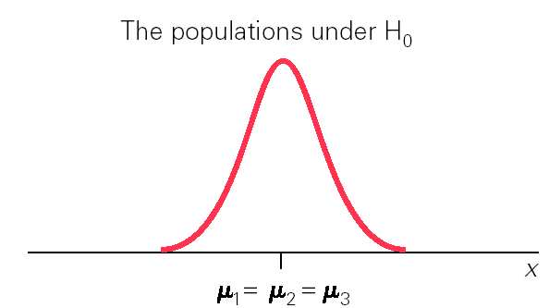
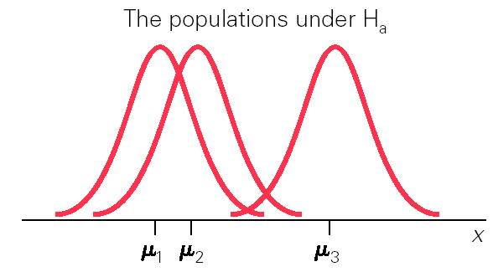
Assumptions for the F-test
Samples are independent random samples
Distribution of response variable is a normal
curve within each population
Different populations may have different means.
All populations have same standard dev. , s.

Slide 71
Conditions for Using the F-Test
F-statistic can be used if data are not extremely skewed, there are no extreme outliers, and group standard deviations are not markedly different.
Tests based on F-statistic are valid for data with skewness or outliers if sample sizes are large.
A rough criterion for standard deviations is that the largest of the sample standard deviations should not be more than twice as large as the smallest of the sample standard deviations.

Slide 72
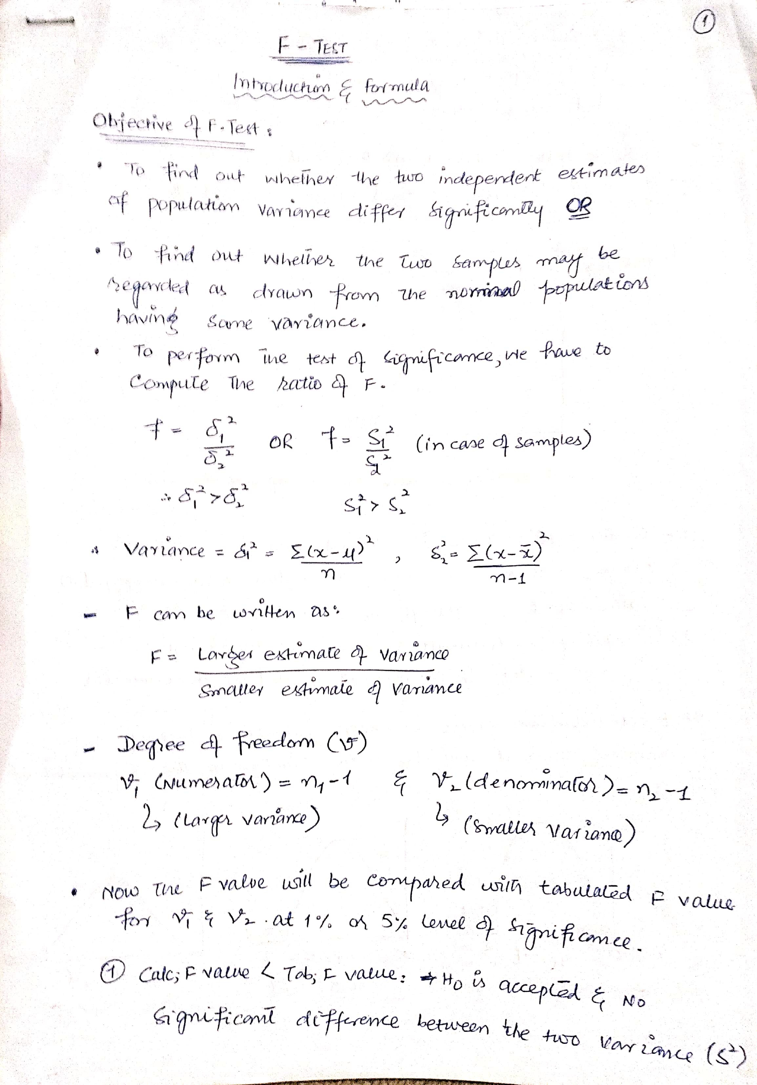
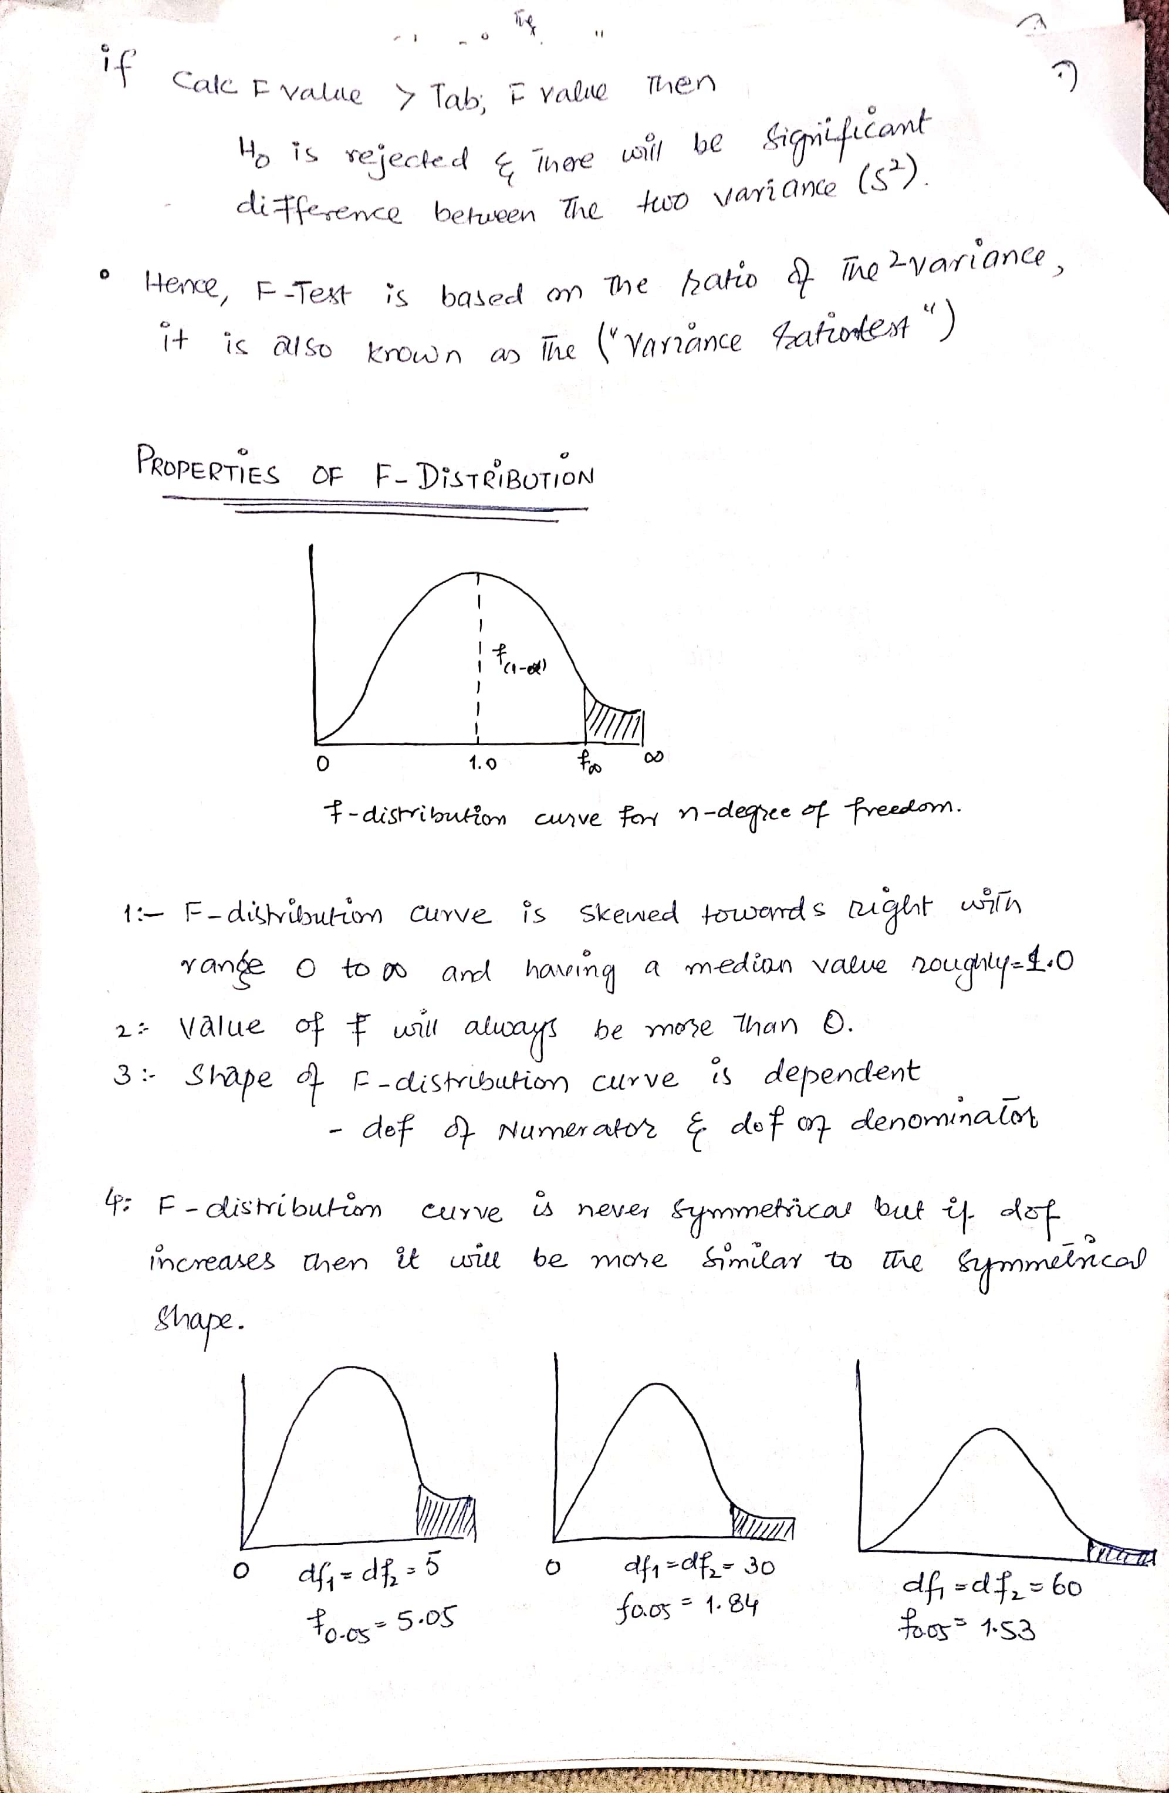
Scanned with CamScanner

Slide 73
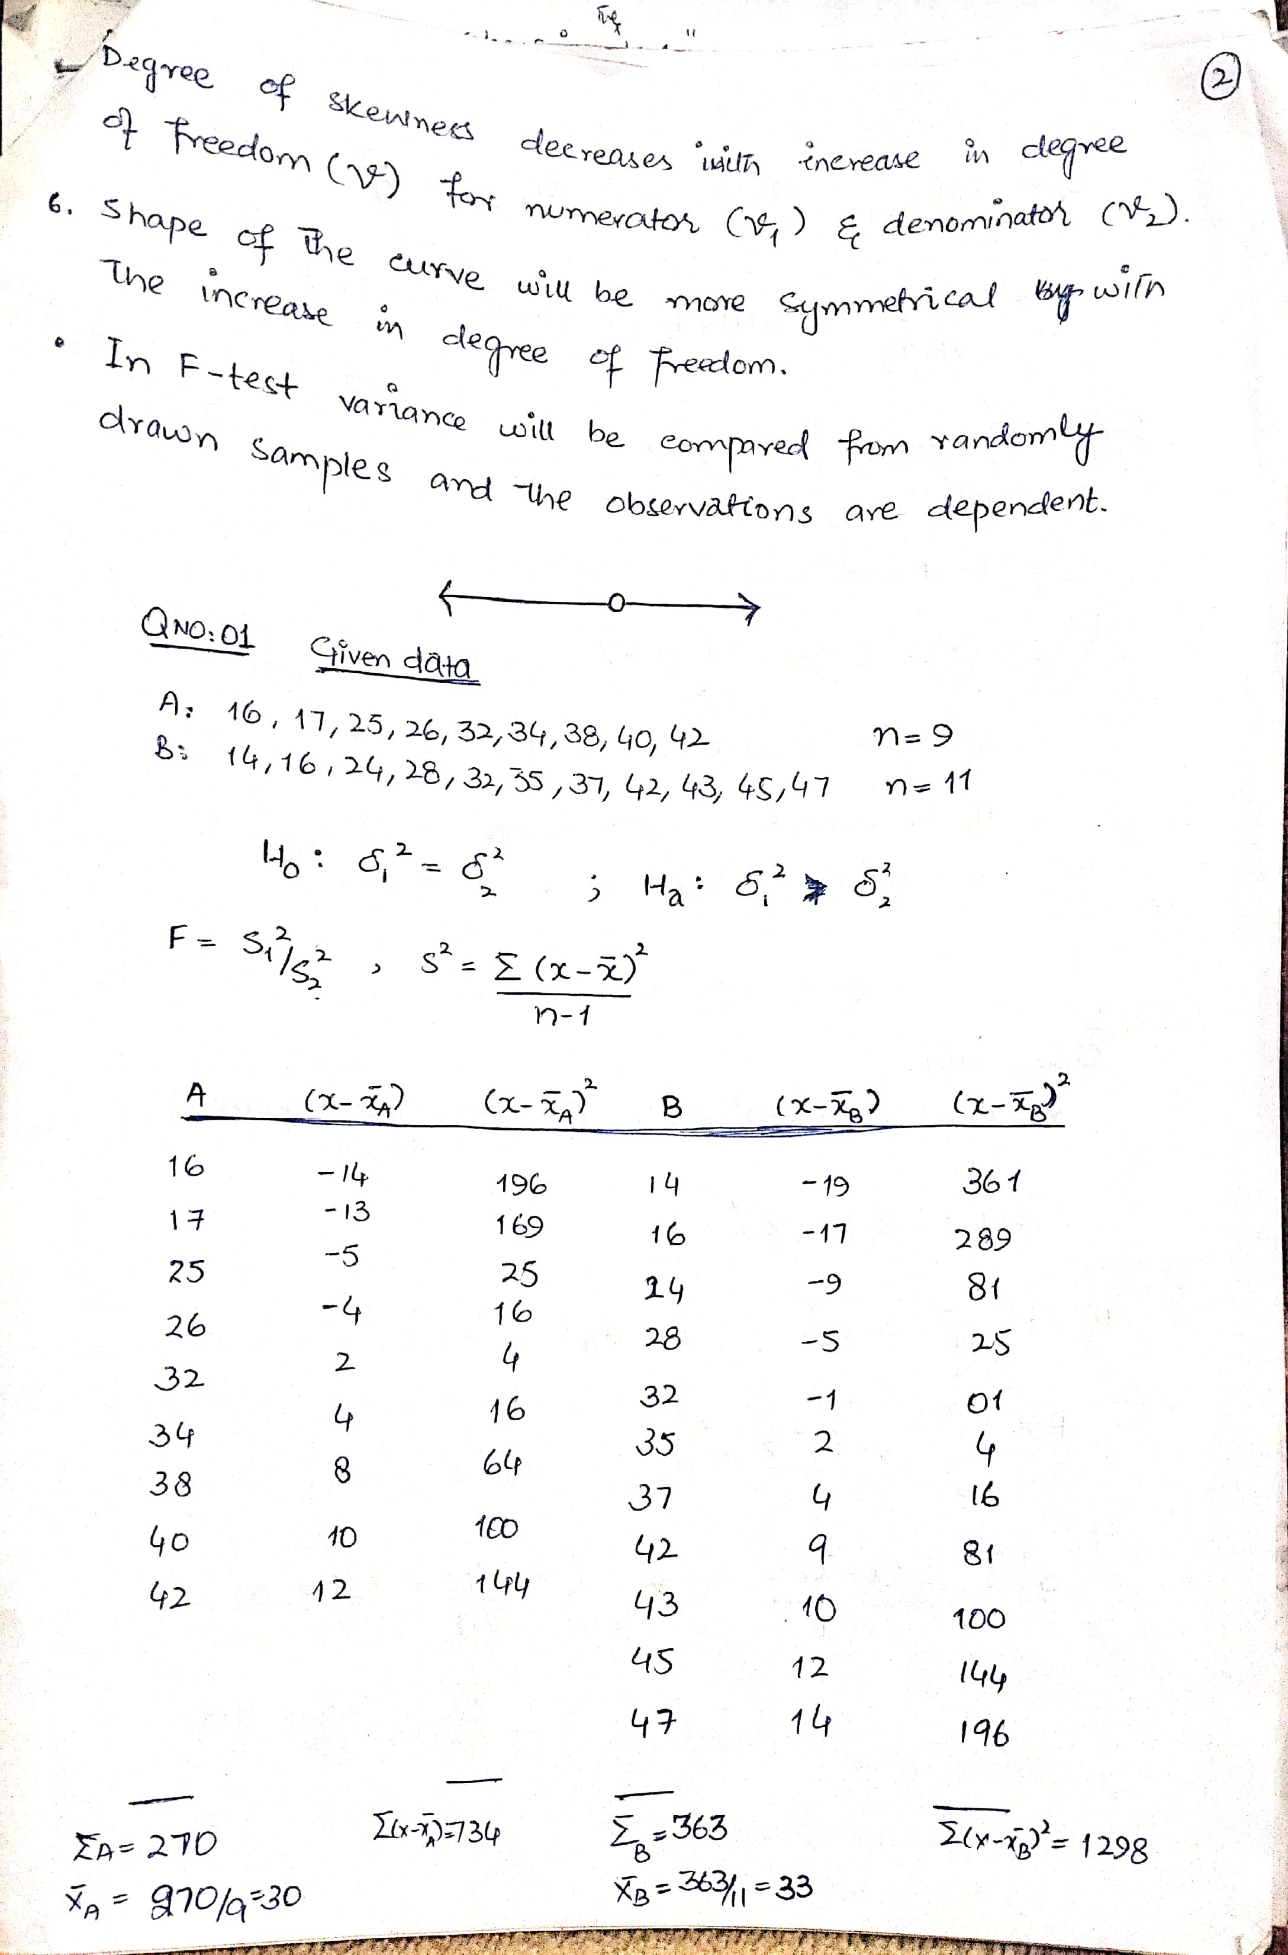
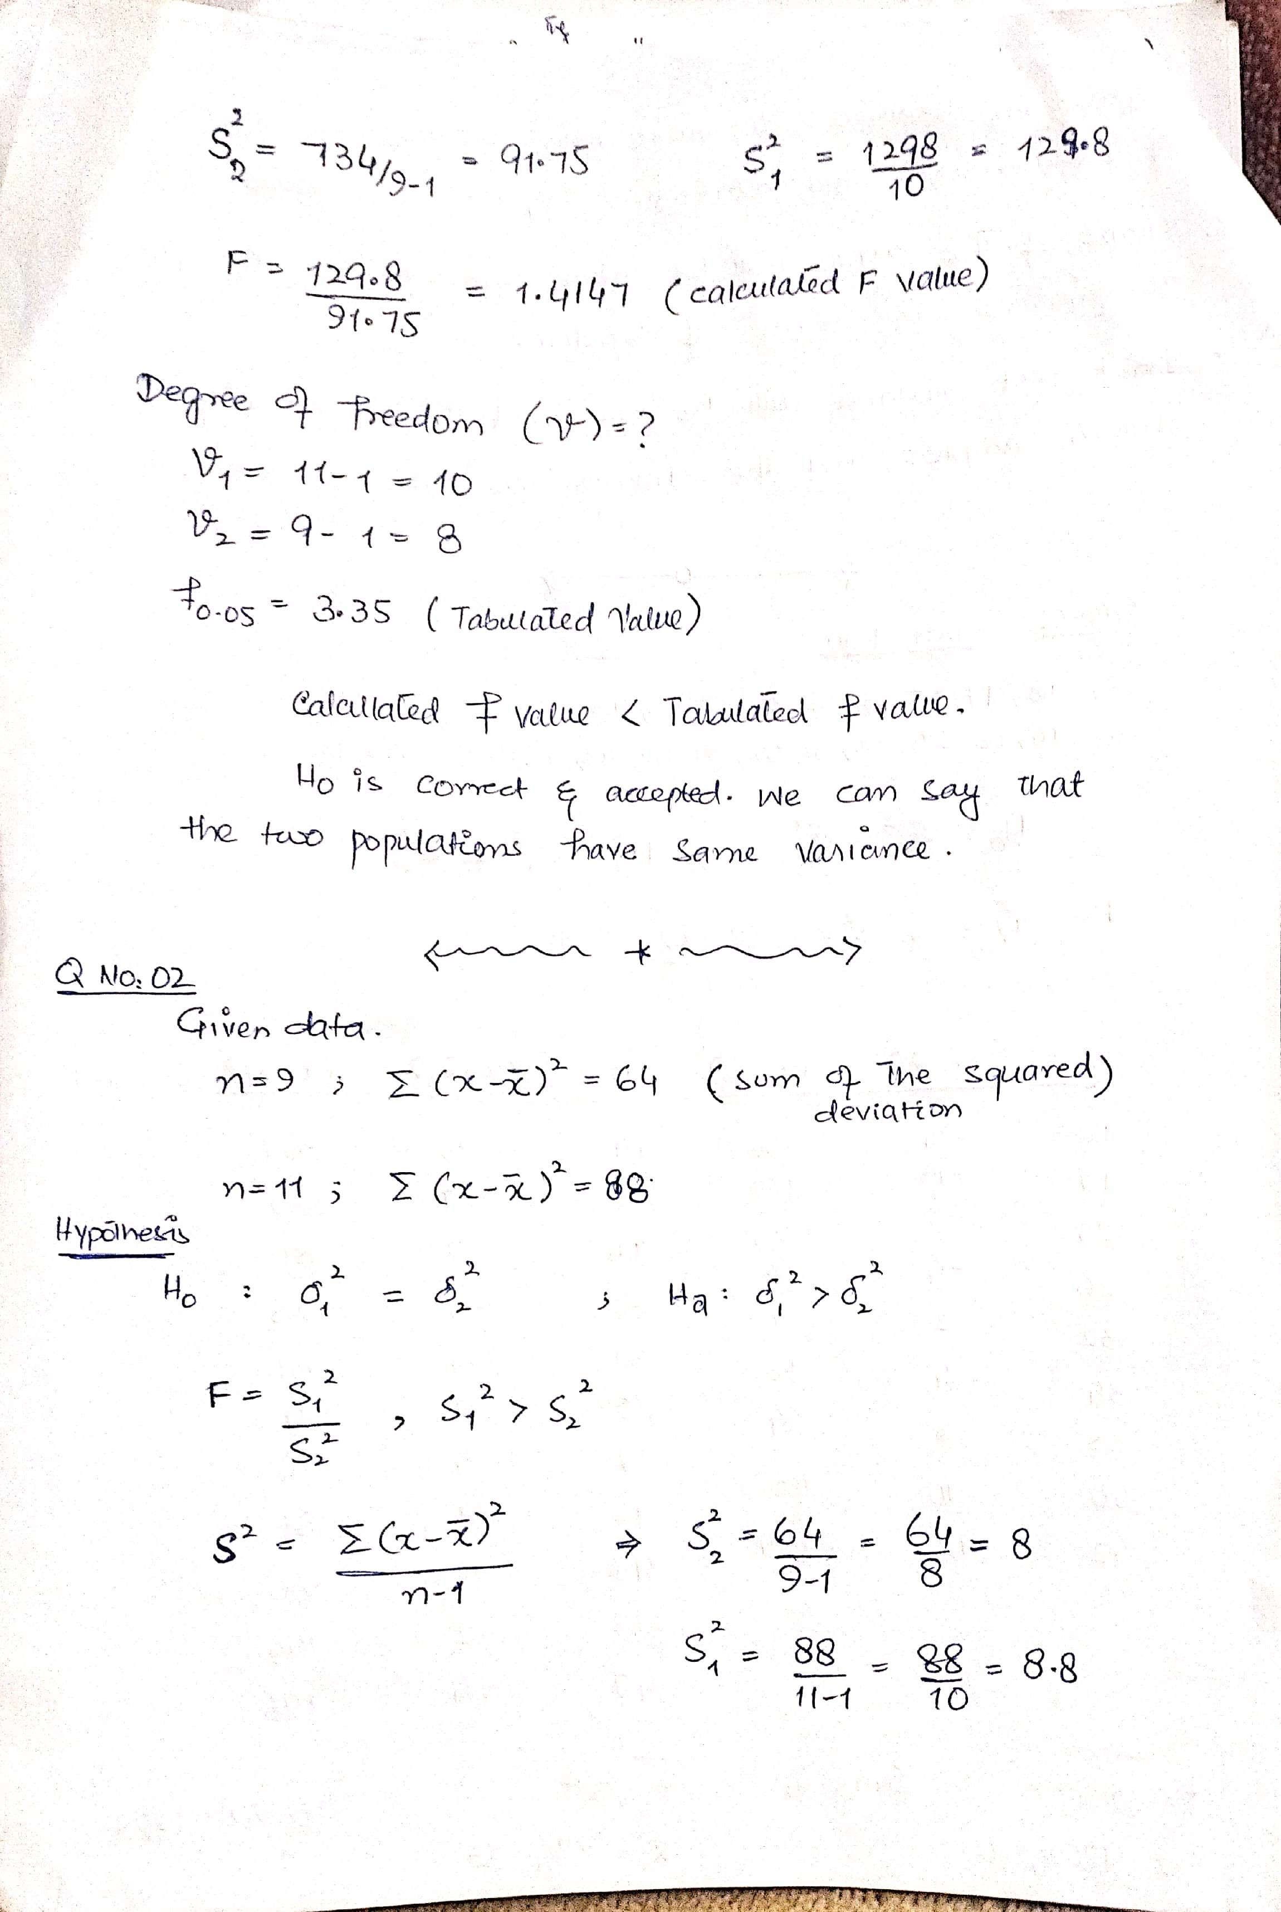
Scanned with CamScanner

Slide 74
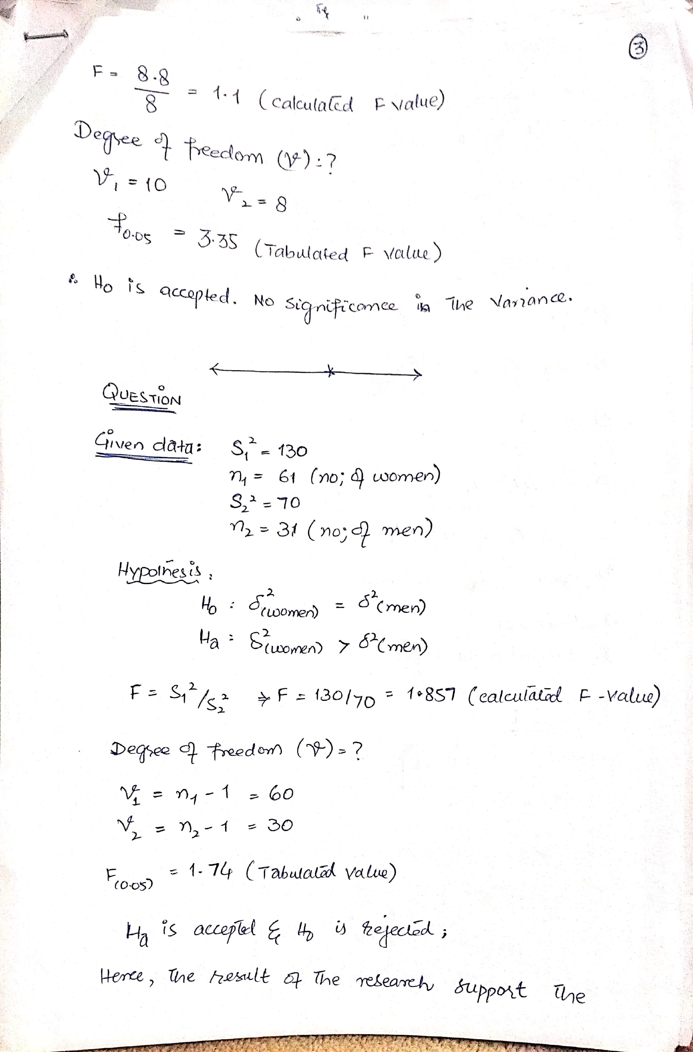
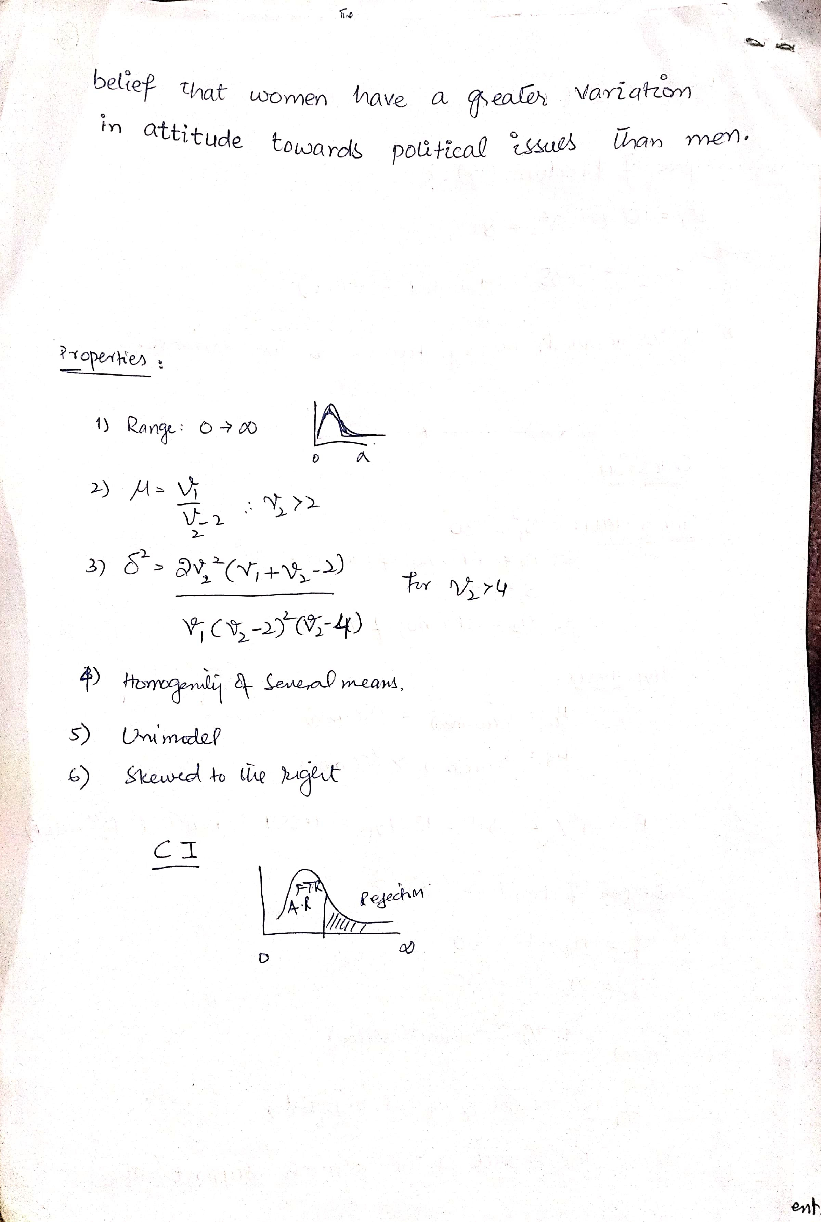
Scanned with CamScanner

